Slide 1
JavaScript & HTML DOM

Slide 2
Quick Recap
Why do we have HTML? What is the structure like?
HTML tags, attributes
Headings, horizontal lines, paragraphs, newlines, comments
Links – href and name
Images – src and alt
Lists, tables, inline and block elements
Forms, inputs and iframes
Why do we have CSS? What are the different ways to insert style?
CSS selector, CSS box model
Shorthand for margin, padding and border
CSS display, visibility, float, overflow and positioning

Slide 3
JavaScript

Slide 4
JavaScript
JavaScript is a scripting language designed to add interactivity to HTML pages.
It is an interpreted language.
You can use it to:
React to events
Manipulate HTML elements
Validate data
Detect the browser
Note that Java and JavaScript are not related.

Slide 5
<script> tag and variables
To fire any js statements, use the <script></script> tag:
<script type="text/javascript"> alert ("Hello World!"); </script> The alert() here throws an alert message.
Script tags can be placed in head or body. (but why?)
To include external js:
<script type="text/javascript" src="myscript.js"></script>
Variables are created using ‘var’ keyword:
var msg = “Hello World!”;
var age = 21;

Slide 6
Arithmetic Operators
Arithmetic Operators
Operator | Description
+ | Addition
- | Subtraction
* | Multiplication
/ | Division
% | Modulus
++ | Increment
-- | Decrement

Slide 7
Assignment Operators
Assignment Operators
Operator | Description
= | Assign
+= | Add and assign
-= | Subtract and assign
*= | Multiply and assign
/= | Divide and assign quotient
%= | Divide and assign remainder

Slide 8
Comparison Operators
Comparison Operators
Operator | Description
== | Equal to (value)
=== | Equal to (value and type)
!= | Not equal to (value)
!== | Not equal to (value and type)
> | Greater than
< | Less than
>= | Greater than or equal to
<= | Less than or equal to

Slide 9
Logical Operators and Conditional Operator
Logical Operators
Conditional Operator
<variable> = (condition) ? <value1> : <value2>
var status = (marks < 33) ? ‘Fail’ : ‘Pass’;
Operator | Description
&& | And-ing
|| | Or-ing
! | Not-ing

Slide 10
Concatenation
+ is also used to concatenate strings.
var msg1 = “Hello”;
var msg2 = “ World!”;
var msg3 = msg1 + msg2;
alert(msg3);
Note: concatenating a number and a string will result in that number.

Slide 11
If … else
This looks like:
if (condition1) {
…
}
else if (condition2) {
…
}
else {
…
}
Note the space in ‘else if’

Slide 12
Popup Boxes
Alert Box
alert(<text>);
To display a message.
Only has Ok button.
Confirm Box
confirm(<text>);
To confirm something.
Has Ok button (true) and Cancel button (false).
Prompt Box
prompt(<text>, <defaultvalue>);
To get some input from user.
Input, Ok button and Cancel button (null).

Slide 13
Functions and Lifetime of variables
These look like:
function <functionname>(<arg1>, <arg2>) {
…
return <somevalue>;
}
Variables defined inside functions (local variables) are only accessible inside that function. Lifetime ends when function ends.
Variables defined outside functions (global variables) are accessible across all functions and scripts on that page. Lifetime ends when the page is closed.

Slide 14
Loops
for
for (<var> = <value>; condition; <var> = <var> + <increment>) {
…
}
while
while (condition) {
…
}
do while
do {
…
} while();

Slide 15
Break, Continue statements and Comments
break is used to break out of a loop
continue will break the current loop and move to the next value
Comments can be made using // or /* … */:
<script type="text/javascript"> // document.write("<p>Hello World!</p>");
/ *
document.write("<p>Hello World!</p>");
document.write("<p>Hello World!</p>");
*/ </script>

Slide 16
Events - 1
Actions detectable by JavaScript.
Allows in creating dynamic web pages.
Defined inside the HTML tags.
Normally used in combination with functions.
For example:
<input type="button" onclick="alert('Hello');" value="Say Hello“ />

Slide 17
Events - 2
Events
Event | Description
onmousedown | On pressing mouse button on an element
onmouseup | On releasing mouse button on an element
onclick | On clicking an element
ondblclick | On double-clicking an element
onmouseover | On moving mouse pointer onto an element
onmousemove | On moving mouse pointer over an element
onmouseout | On moving mouse pointer off an element
onload | On load of an object
onunload | On leaving the page (only <body> , <frameset>)
onresize | When element gets resized

Slide 18
Events - 3
Events
Event | Description
onfocus | When a form element gets focus
onchange | When content, checked state or selection of a form element changes
onblur | When a form element loses focus
onsubmit | On page submit

Slide 19
JavaScript Objects
JavaScript is an Object Based Programming language.
It offers certain built-in JavaScript objects:
JS Array
JS String
JS RegExp
JS Date
and more …
Objects have methods and properties.

Slide 20
JS Array – 1
Created by:
var cars = new Array(“Swift",“Indica",“A-Star");
var cars = [“Swift",“Indica",“A-Star"];
Use length property to get array length:
alert(cars.length);
There are also some useful methods.

Slide 21
JS Array – 2
Methods
Method | Description
push() | Adds element at the end (and returns new length)
pop() | Removes last element (and returns that element)
unshift() | Adds element at the start (and returns new length)
shift() | Removes first element (and returns that element)
concat() | Returns multiple arrays joined together
sort() | Sorts all elements
reverse() | Reverses the order of elements
join() | Returns a string will all the elements joined
slice() | Returns an array slice

Slide 22
JS String - 1
Created by:
var msg = new String(“Hello World!");
var msg = “Hello World!”;
Use length property to get array length:
alert(msg.length);
There are also some useful methods.

Slide 23
JS String - 2
Methods
Method | Description
toLowerCase() | Converts string to lowercase.
toUpperCase() | Converts string to uppercase.
match() | Matches a regex and return the matches (returns null if no match)
search() | Matches a regex or specified value and returns the position of the match (returns -1 if no match)
replace() | Matches a regex or specified value and returns new string with specified value replaced.
spilt() | Returns an array with string split by separator.
substr() | Returns a string starting at specified position and upto length specified.

Slide 24
JS RegExp
Created by:
var regex = new RegExp(pattern, modifiers);
var regex = /pattern/modifiers;
test() returns true if there is a match else returns false
var str = “Hello World!”;
var regex = /hello/i;
var exists = regex.test(str);
exec() returns matched text else returns null
var str = “Hello World!”;
var regex = /hello/i;
var result = regex.exec(str);

Slide 25
JS Date - 1
Created by:
var d = new Date();
var today = new Date(); // current date and time
var d = new Date(milliseconds);
var date = new Date(1000); // 1 second since 1970/01/01
var d = new Date(dateString);
var date = new Date("October 13, 1975 11:13:00")
var d = new Date(year, month, day, hours, minutes, seconds, milliseconds);
var d = new Date(1975, 9, 13); // Not specifying causes 0 to be passed in
There are also some useful methods.

Slide 26
JS Date - 2
Methods
Method | Description
getTime() | Returns number of milliseconds since midnight Jan 1, 1970
getFullYear() | Returns the year (four digits)
getMonth() | Returns the month (from 0-11)
getDate() | Returns the day of the month (from 1-31)
getDay() | Returns the day of the week (from 0-6) [Sunday being 0]
getHours() | Returns the hour (from 0-23)
getMinutes() | Returns the minutes (from 0-59)
getSeconds() | Returns the seconds (from 0-59)
getMilliseconds() | Returns the milliseconds (from 0-999)

Slide 27
JS Date - 3
Methods
Method | Description
setTime() | Sets date by adding / subtracting specified milliseconds to / from midnight Jan 1, 1970
setFullYear() | Set the year (four digits)
setMonth() | Sets the month (from 0-11)
setDate() | Setns the day of the month (from 1-31)
setHours() | Sets the hour (from 0-23)
setMinutes() | Sets the minutes (from 0-59)
setSeconds() | Sets the seconds (from 0-59)
setMilliseconds() | Sets the milliseconds (from 0-999)

Slide 28
HTML DOM

Slide 29
Learning Objectives
What is the HTML DOM?
How to make use of it?

Slide 30
Quick JS Revision
What is JS used for?
How do we execute JS?
What are the different types of variables?
What are the different events?
What are the different JS Objects?

Slide 31
HTML DOM
To understand how JavaScript interacts with websites, we first have to know about the Document Object Model (DOM).
The DOM is a representational structure of HTML documents.
It is a standard for how to get, change, add, or delete HTML elements.

Slide 32
DOM Nodes
The DOM says:
The entire document is a document node.
Every HTML element is an element node.
The text in the HTML elements are text nodes.
Every HTML attribute is an attribute node.
Comments are comment nodes.
So the entire html page can be considered as a tree-like structure.
And so you’ll have parent, children and sibling relationships.

Slide 33
Sample HTML Page
<!DOCTYPE html>
<html>
<head>
<title>My home page</title>
</head>
<body>
<h1>My home page</h1>
<p>Hello, I am Marijn and this is my home page.</p>
<p>I also wrote a book! Read it
<a href="http://eloquentjavascript.net">here</a>.
</p>
</body>
</html>

Slide 34
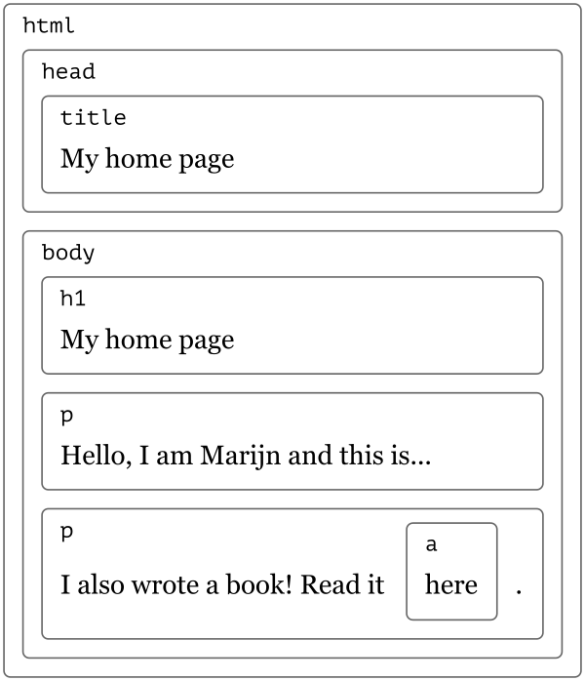
Document Object Model

Slide 35
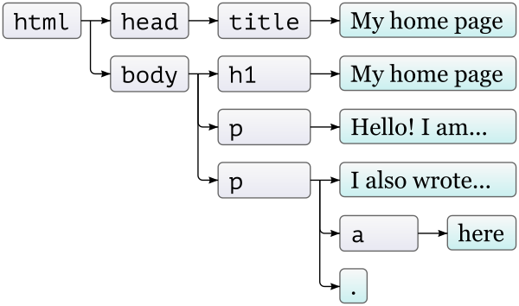
Document Tree

Slide 36
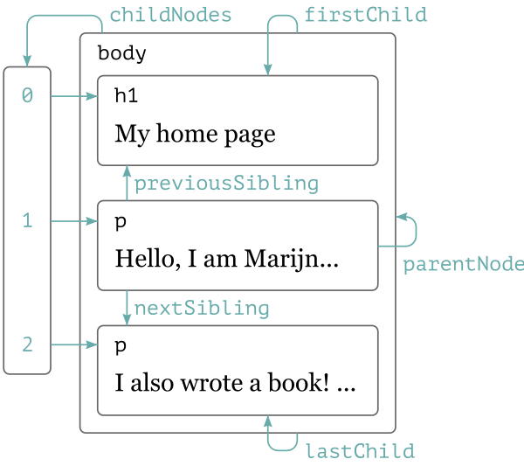
Moving Through The Tree

Slide 37
Core DOM Interfaces - Access Elements
getElementById()- Returns element with the specified ID
var testdiv = document.getElementById(‘mydiv’);
getElementsByName()- Returns all elements with the specified name
var testdivs = document.getElementsByName(‘myname’);
getElementsByTagName() - Returns all elements with specified tag
var container = document.getElementById(‘mydiv’);
var testdivs = container.getElementsByTagName(‘div’);
getElementsByClassName() - Returns all elements with specified class
var container = document.getElementById(‘mydiv’);
var testdivs = container.getElementsByClassName(‘myclass’);

Slide 38
Core DOM Interfaces - Change Elements
Changing html
var html = document.getElementById(‘mydiv’).innerHTML;
document.getElementById(‘myotherdiv’).innerHTML = html;
Changing attributes
var value = document.getElementById(‘myinputname’).value;
document.getElementById(‘myinputname’).value = value;
Changing appearance
var color = document.getElementById(‘mydiv’).style.color;
document.getElementById(‘myotherdiv’).style.color = color;

Slide 39
Exercise
Demo 1 - Change Elements

Slide 40
Core DOM Interfaces – Add & Remove Elements
Creating an element
var mydiv = document.createElement(‘div’);
Adding an element
document.body.appendChild(mydiv);
Removing an element
document.body.removeChild(mydiv);

Slide 41
Exercise
Demo 2 - Create & Remove Elements

Slide 42
Core DOM Interfaces – Add Event Listeners
addEventListener() - Registers an event listener on the element
Syntax - target.addEventListener(type, listener);
target - an Element in a document, the Document itself, a Window, or any other object that supports events.
type - A string representing the event type to listen for.
listener - The object that receives a notification when an event of the specified type occurs.
Example -
document.addEventListener(‘click’, function () {
alert('Click on document');
});

Slide 43
Exercise
Demo 3 - Selectors & Events

Slide 44
Exercise
Demo 4 - Form Validation
Create the usual form with various form elements, and add in validation
Segregate JS and CSS in separate .js and .css files, and include them in the HTML file

Slide 45
References
Introduction to the DOM on MDN
The Document Object Model chapter from Eloquent JavaScript

Slide 46
Any Questions?

